Slide 1
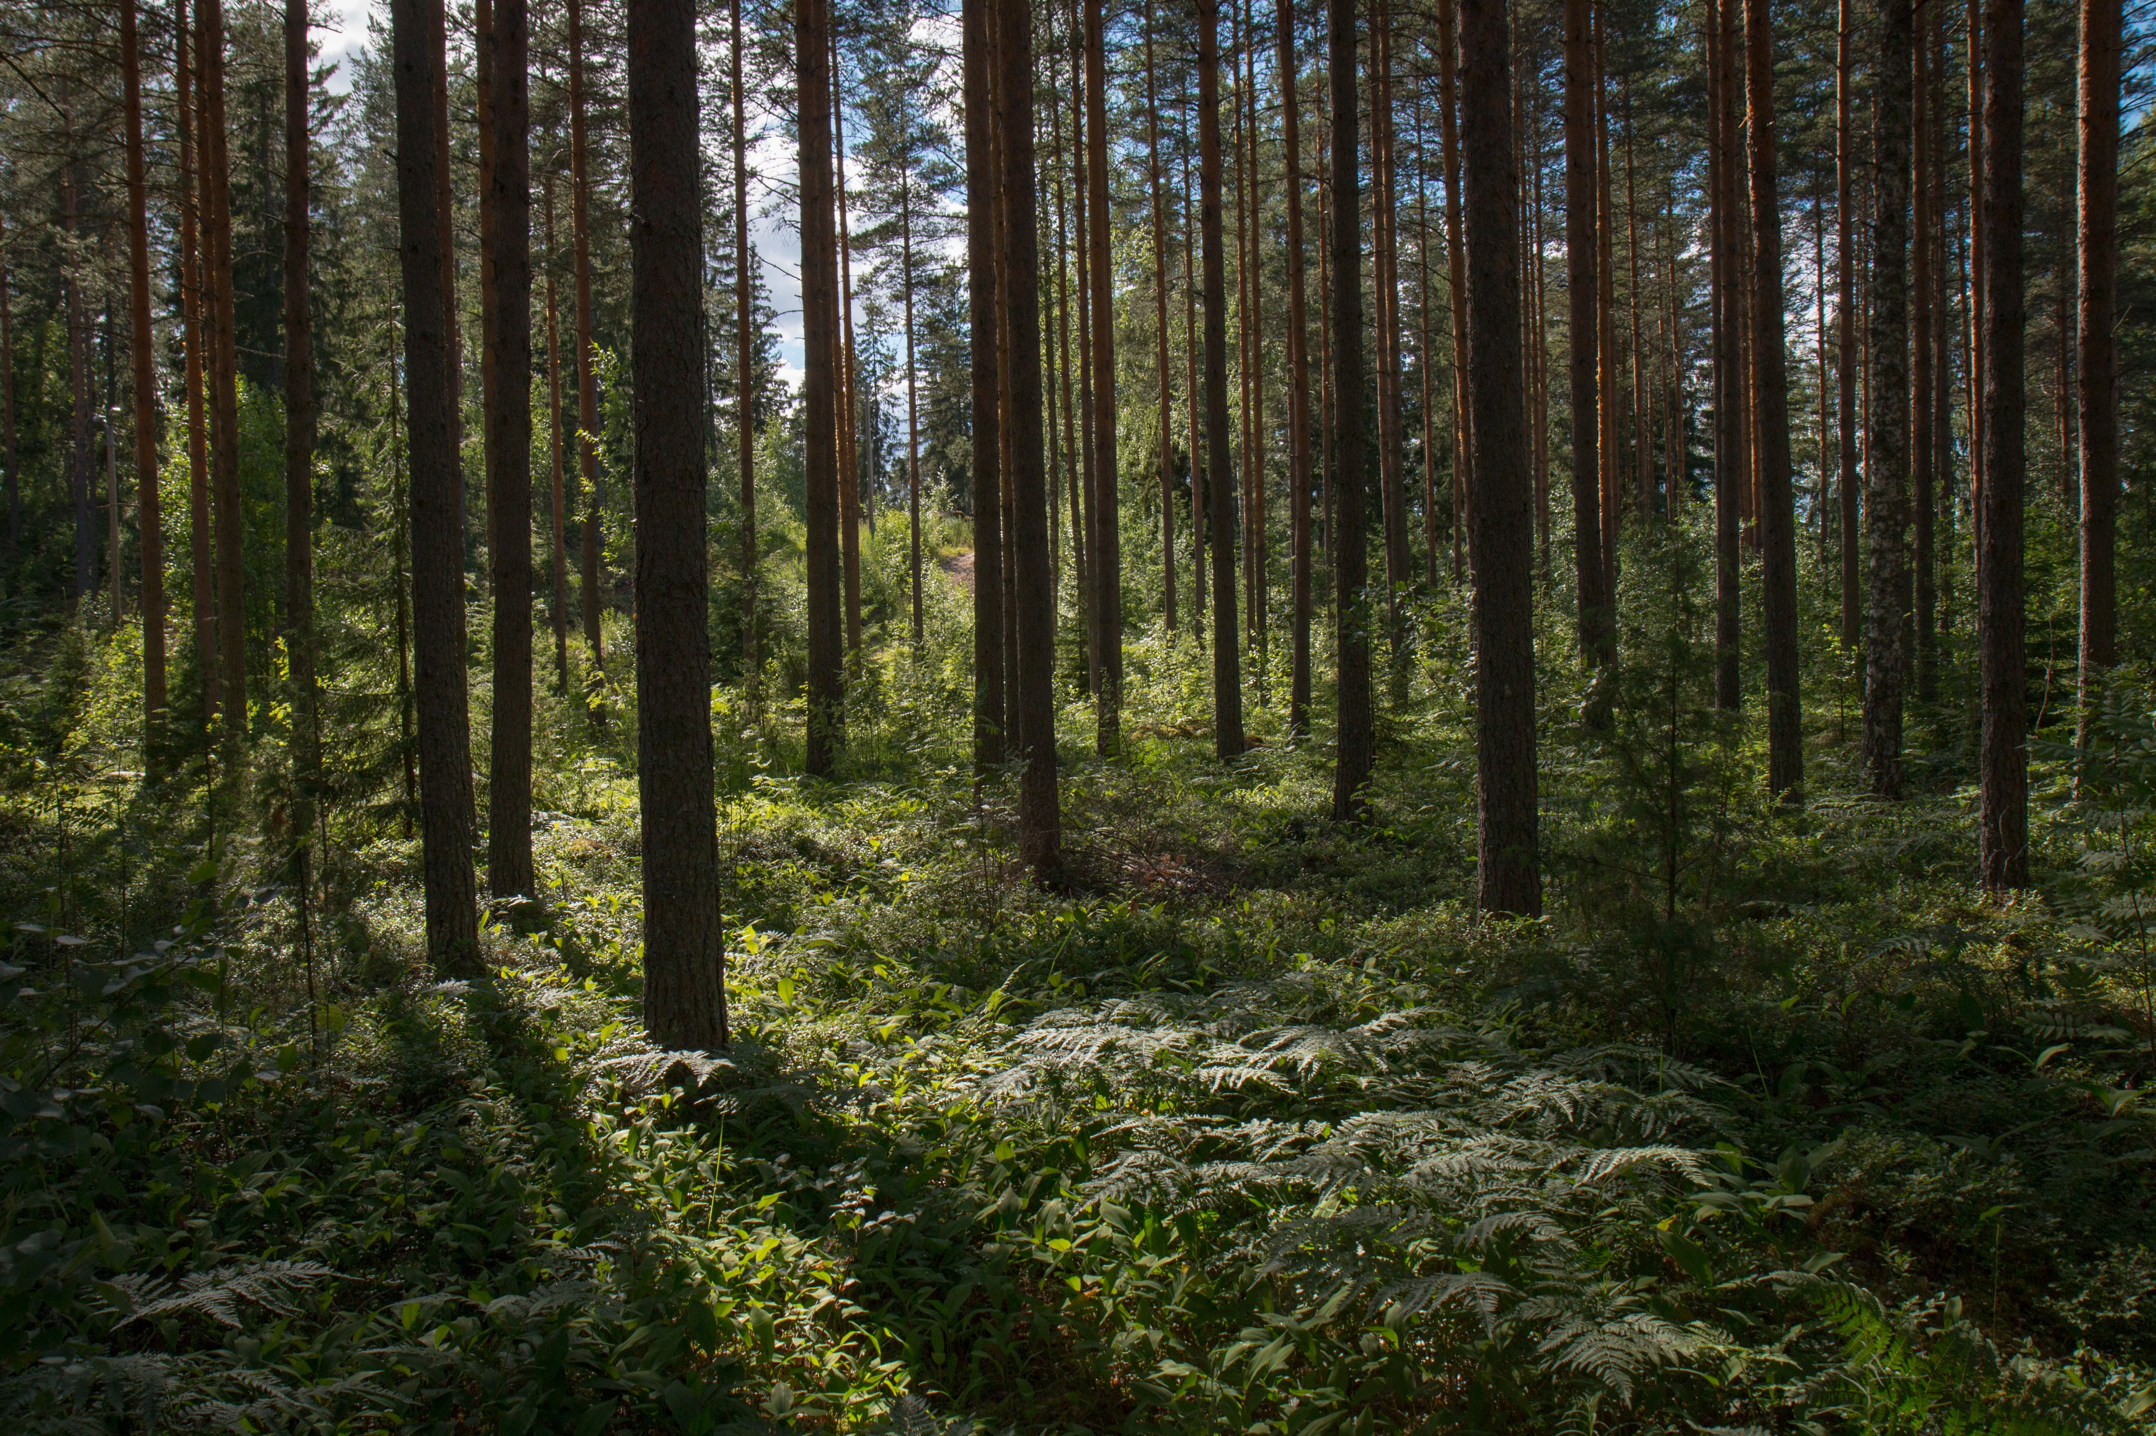
Forestplots in R

Slide 2
Motivation

Slide 3
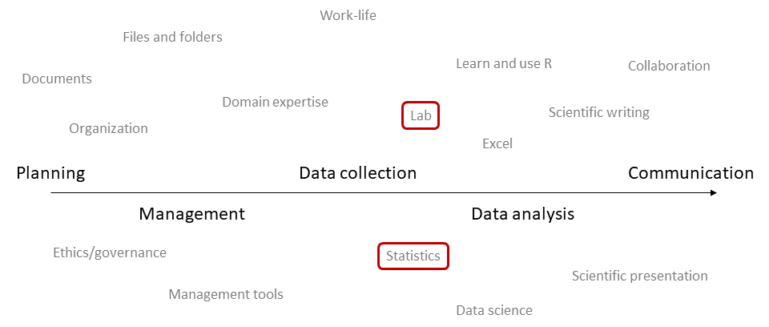
With a few exceptions, we are bad at sharing
skills and knowledge necessary to thrive as researchers

Slide 4
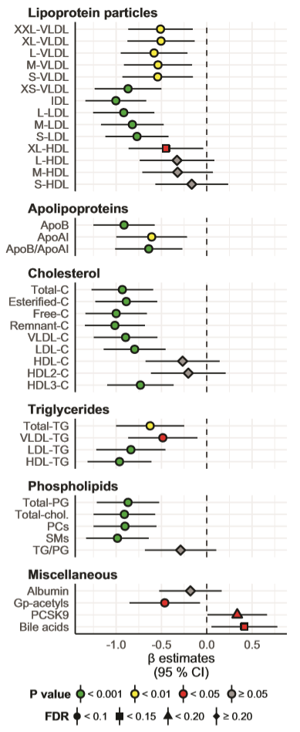
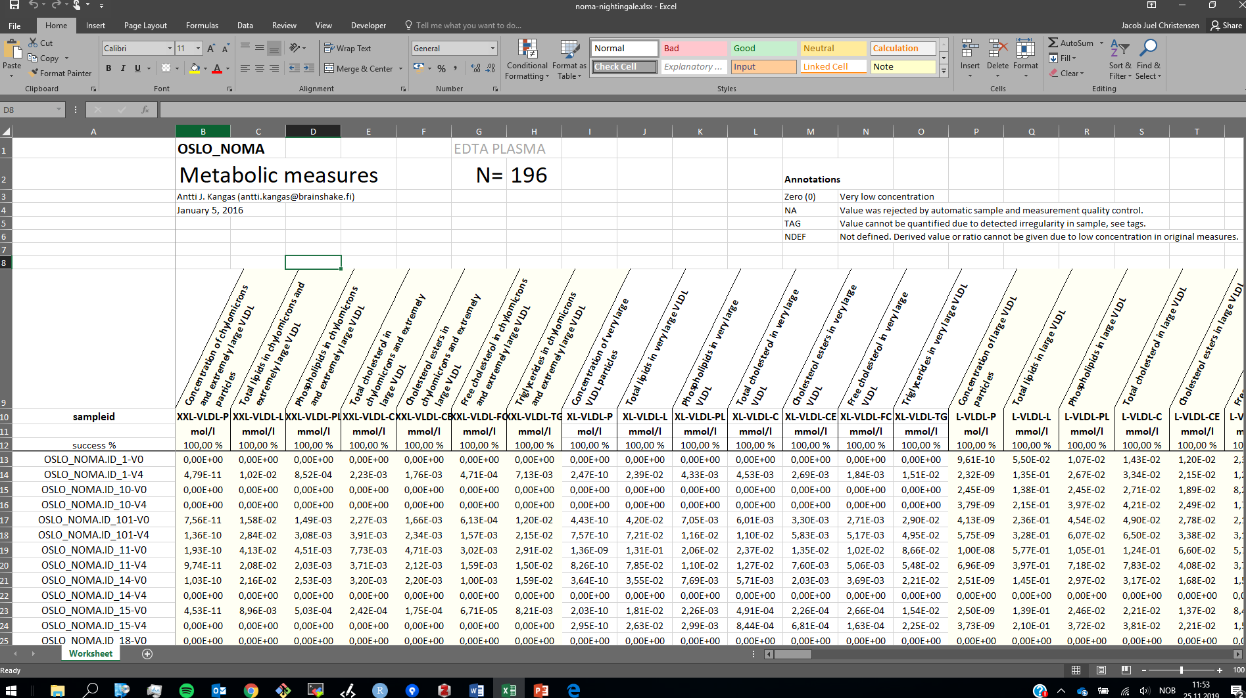
The aim for this session:
How to go from raw Nightingale NMR metabolomics data…
… to a publication-ready forestplot using R

Slide 5
Cheatsheet handouts

Slide 6
Check out
the 01-basics script

Slide 7
The data science workflow

Slide 8
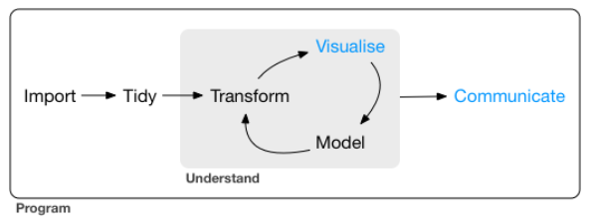
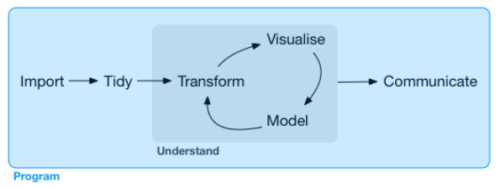
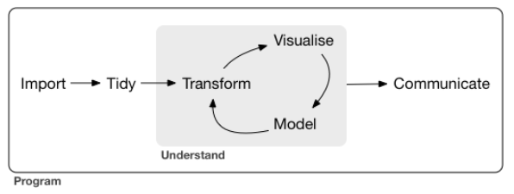
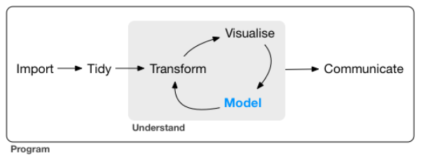
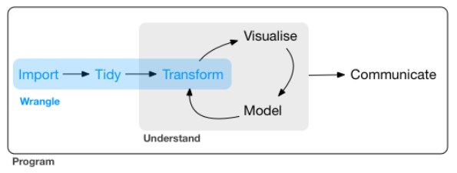
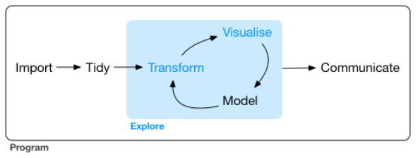
The distinct phases in a data analysis workflow are:
import, tidy, transform, visualize, model, and communicate

Slide 9
I usually separate the analysis into scripts, like chapters
in a book, or a sequence of specific lab procedures
Other analysis tool
SPSS
Stata
SAS
Excel
Results
Excel (.xlsx)
CSV (.csv)
Text (.txt)
Intermediary data files
RData (.RData)
RDS (.rds)
dplyr
forcats
stringr
lubridate
Raw data
Annotations
Excel (.xlsx)
SPSS (.sav)
CSV (.csv)
Text (.txt)
readr
haven
readxl
ggplot2
Results
Tables (.xlsx)
Figures (.png, .pdf)
Reports (.html)
Manuscripts (.docx)
tibble
tidyr
rmarkdown
knitr
broom
purrr
magrittr
Intermediary data files
RData (.RData)
RDS (.rds)

Slide 10
Forestplot details

Slide 12
Figure number
Ordering of variables
that highlights/emphasizes
main points in the story
Regression estimate
Upper and lower CI
Nicely formatted
variable names
Nicely formatted
variable group names
Abbreviation list
Theme
Legend
Zero line
Etc…
Normalized effect sizes
P value group fill color
FDR value group symbol

Slide 13
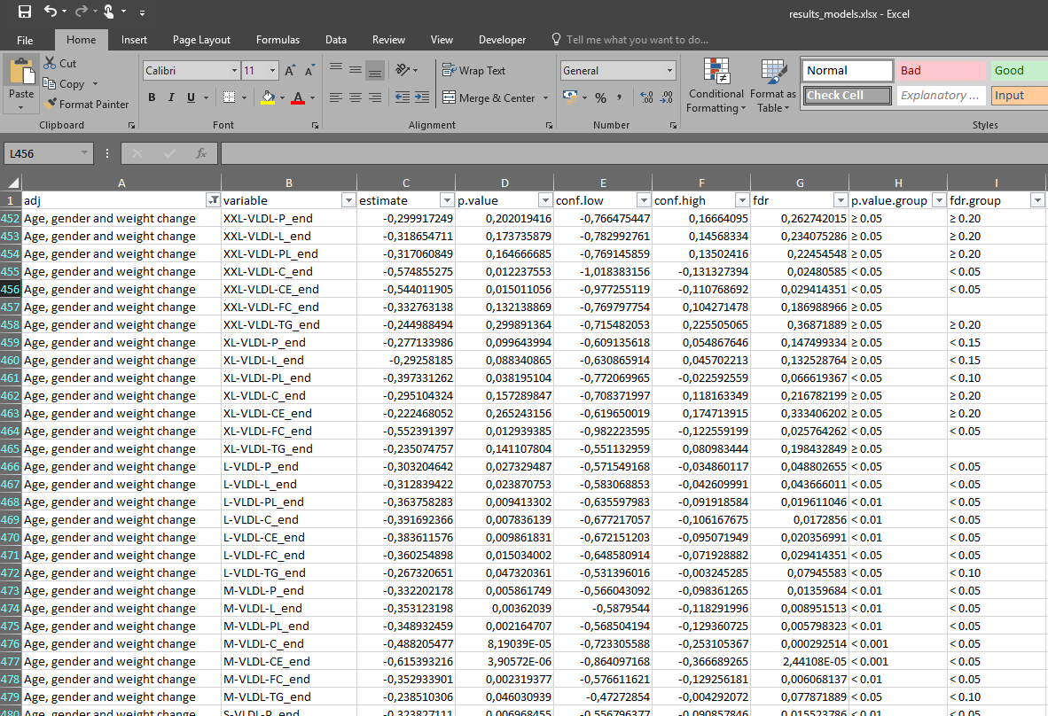
Regression
estimate
Upper and
lower CI
P value group
fill color
FDR value
group symbol

Slide 14
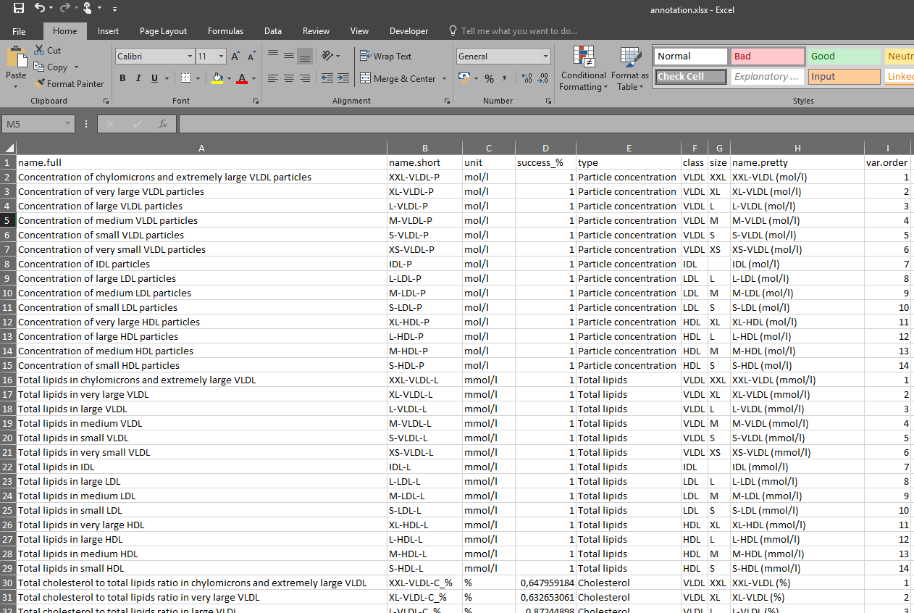
Abbreviations
Ordering of variables
that highlights/emphasizes
main points in the story
Nicely formatted
variable group names
Nicely formatted
variable names
Units
Notes:
At this point, go to the Excel sheets to take a closer look at them

Slide 15

Structure your work around the use of raw data tables, results tables and annotation (meta-data) tables
Estimates, CIs, P values
Pretty names, variable groups, units ++
Variables
Results
Annotations
Raw data
glm
cor
…
+
IDs
Variables
Variables
Excel
Results
Annotations
=
Figures
Tables

Slide 16
Check out
the data files and
annotation files

Slide 17
Create an
R Markdown document

Slide 18
Check out
the 05-viz script

Slide 19
The data science workflow
(detailed)

Slide 20
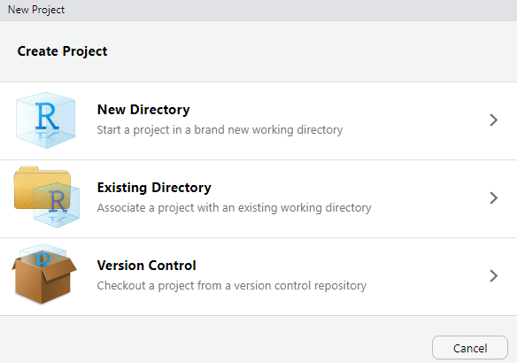
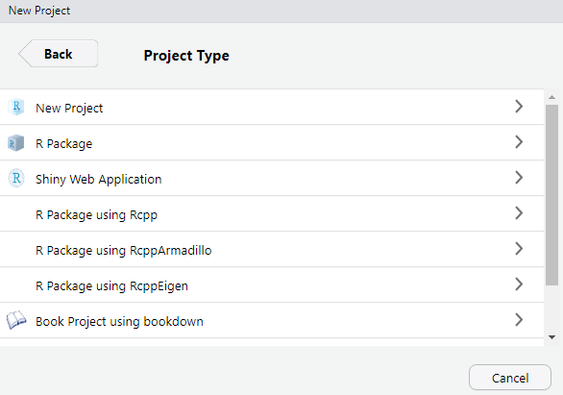
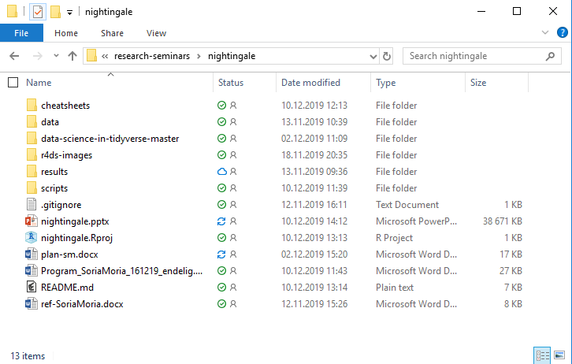
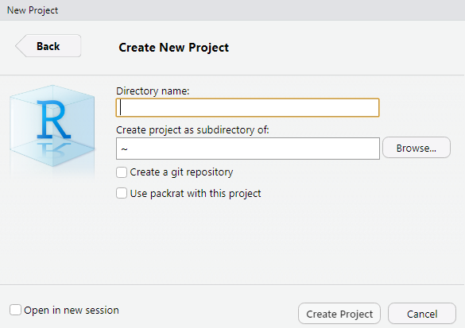
Use RStudio Projects to organize your work
File → New Project

Slide 21

Keep your directory structure clean, tidy and consistent
project-name/
project-name.Rproj
README (.md, .docx)
data/
scripts/
results/
.Rmd
.R
raw/
processed/
figures/
tables/
reports/
raw-data (.csv, .xlsx, .sav)
annotation.xlsx
.png
.pdf
.xlsx
.html
intermediate-data (.RData, .rds)

Slide 22

A directory of functions

Slide 23


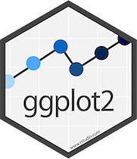
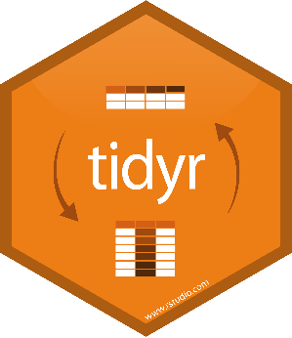







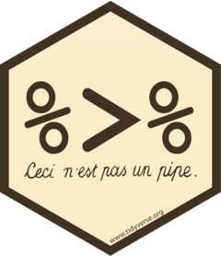

tidyverse packages and functions that will get you started
gather/spread
pivot_longer/pivot_wider
separate/unite
nest/unnest
read_csv
read_delim
tibble
tribble
filter
select
arrange
mutate
summarise
left_join
bind_rows
read_xlsx
str_detect
str_subset
str_replace_all
str_sub
tidy
glance
augment
map
map_dbl
map_chr
map2
%>%

Slide 24

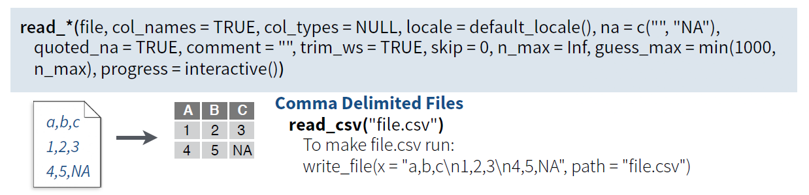
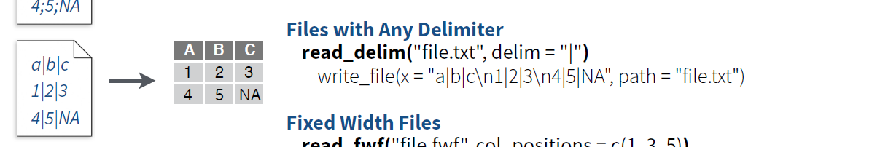
Use the read_* and write_* family of functions
to get tabular data in and out of R
rstudio cheatsheets

Slide 25
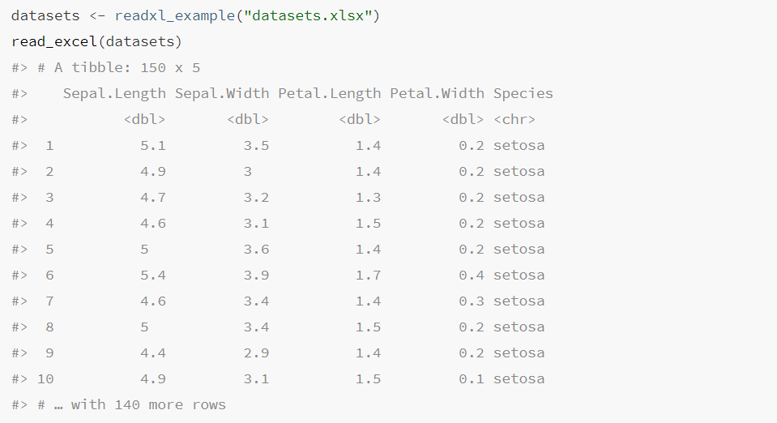
Use read_excel to read Excel sheets
rstudio cheatsheets

Slide 26
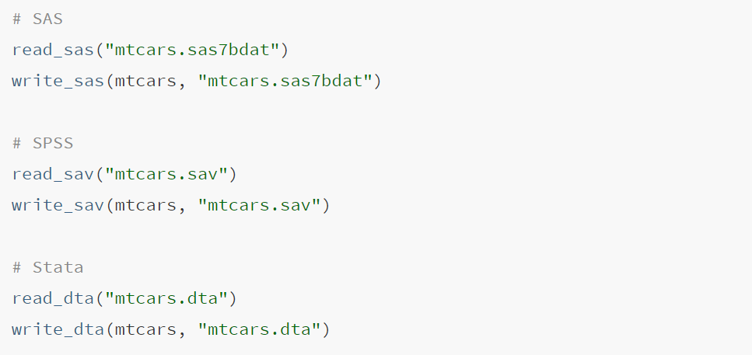
Use read_sav and write_sav to read
and write SPSS files, respectively
rstudio cheatsheets

Slide 27
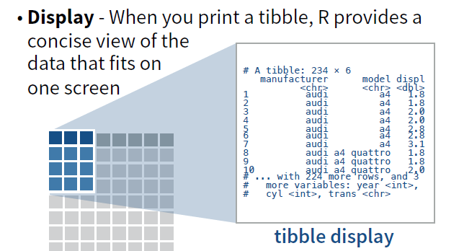
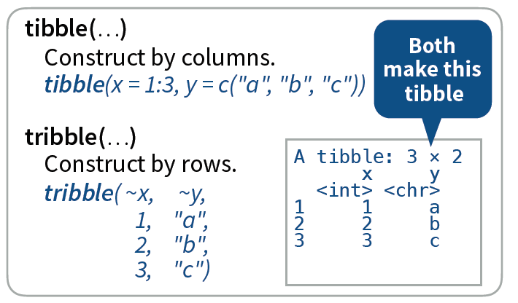
The tidyverse uses a tibble, an enhanced data frame,
to store tabular data
rstudio cheatsheets

Slide 28

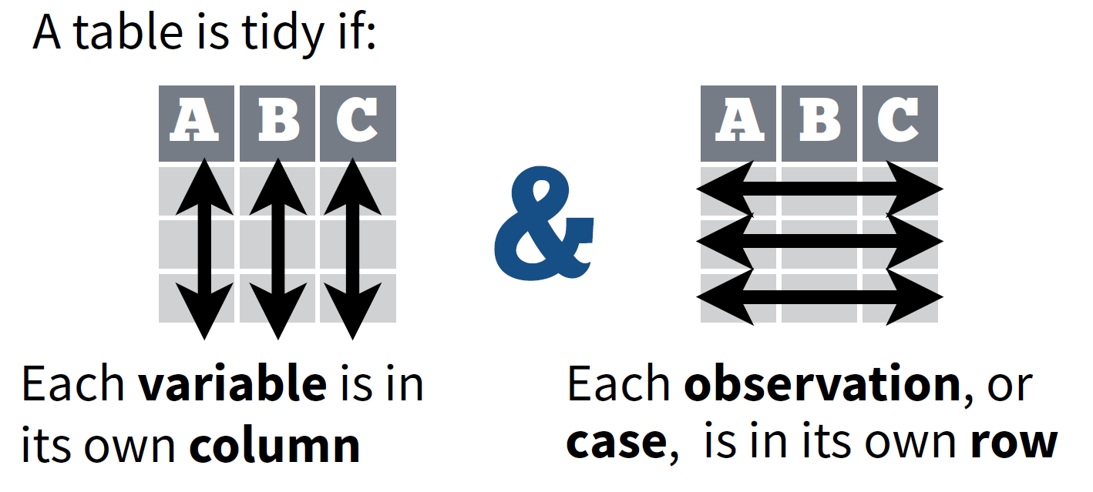
Tidy data is a way to organize tabular data; it provides
a consistent data structure across packages
rstudio cheatsheets

Slide 29
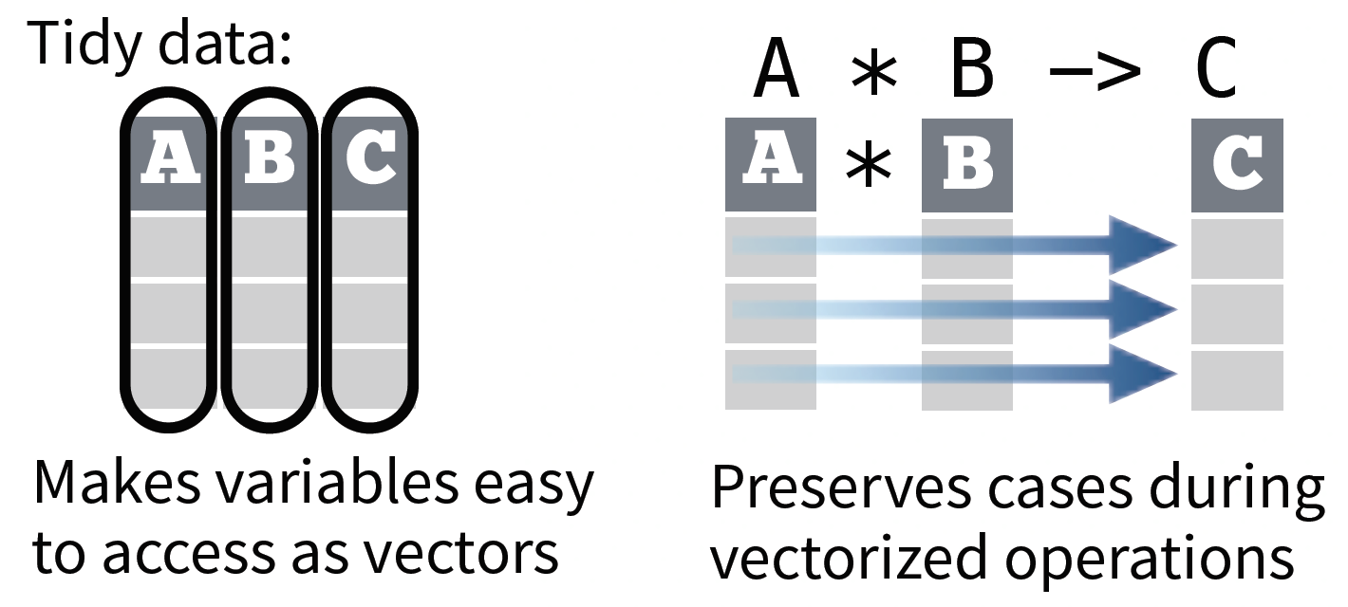
Tidy data makes variables easy to access as vectors,
and preserves cases during vectorized operations
rstudio cheatsheets

Slide 30
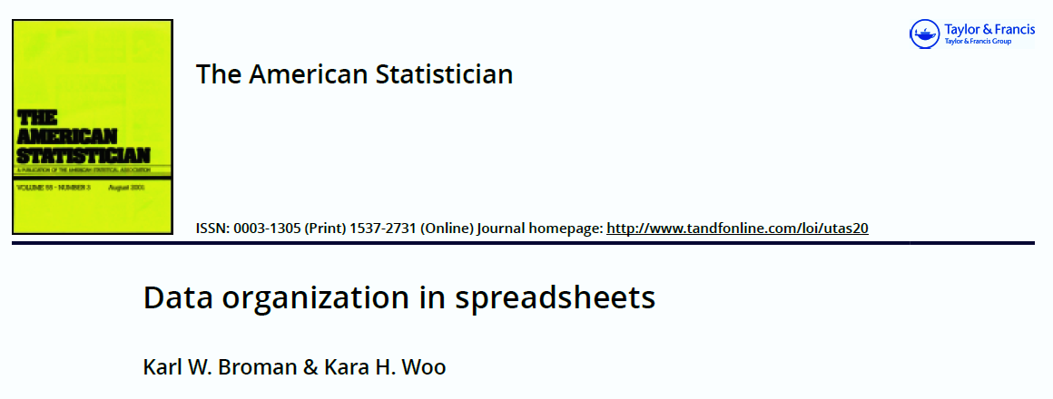
Follow the principles by Broman and Woo when you organize data in spreadsheets
Be consistent
Write dates like YYYY-MM-DD
Don’t leave any cells empty
Put just one thing in a cell
Organize the data as a single rectangle
Subjects in rows; variables in columns; single header
Create a data directory
Don’t include calculations in the raw data files
Don’t use font color or highlighting as data
Choose good names for things
Make backups
Use data validation to avoid errors
Save the data in plain text file
See separate lecture on
data organization in spreadheets!

Slide 31
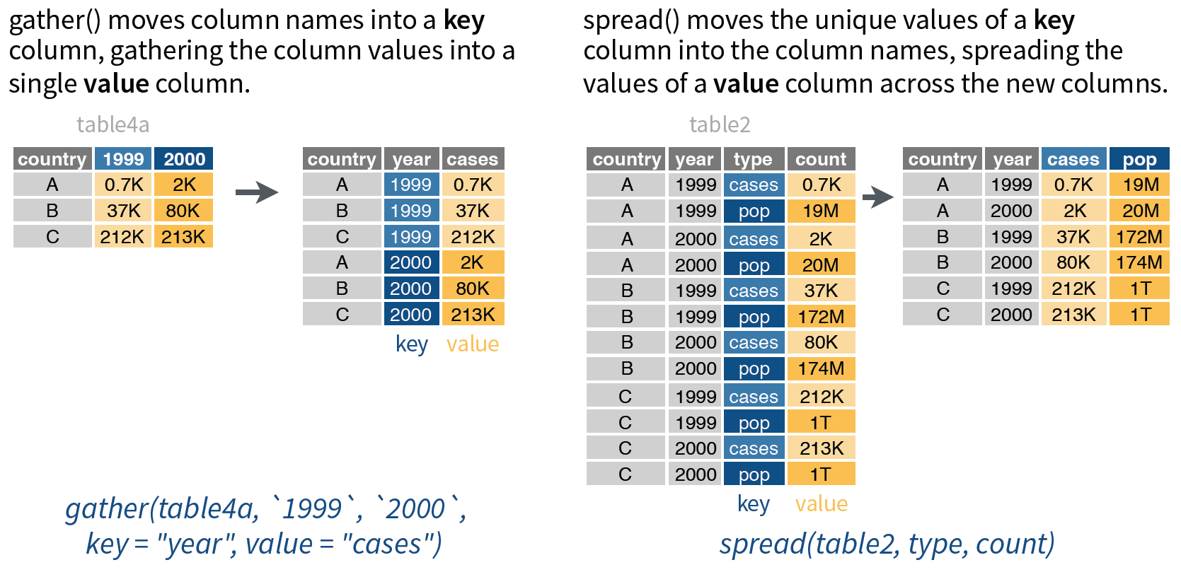
Use gather and spread pivot_longer and pivot_wider
to reorganize the values of a table into a new layout
rstudio cheatsheets
pivot_longer(table4a, `1999`, `2000`,
names_to = “year", values_to = “cases")
pivot_wider(table2,
names_from = type, values_from = count)

Slide 32
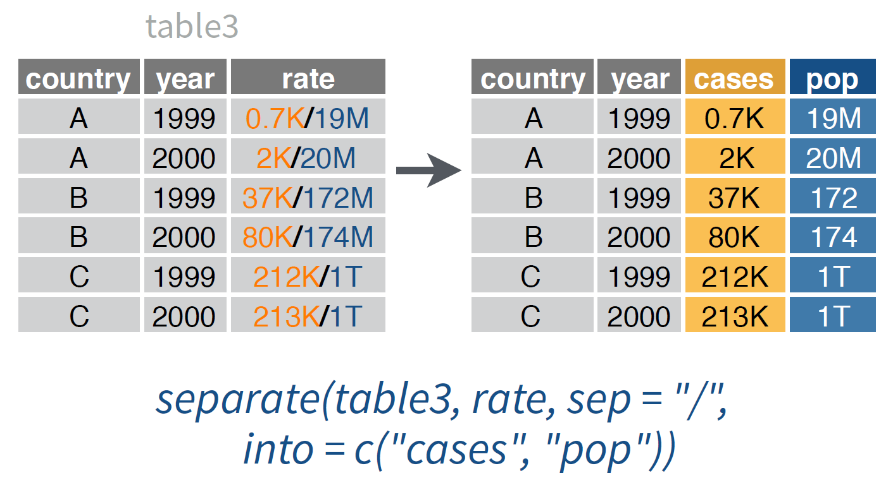
Use separate to split each cell in a column
to make several columns
rstudio cheatsheets

Slide 33
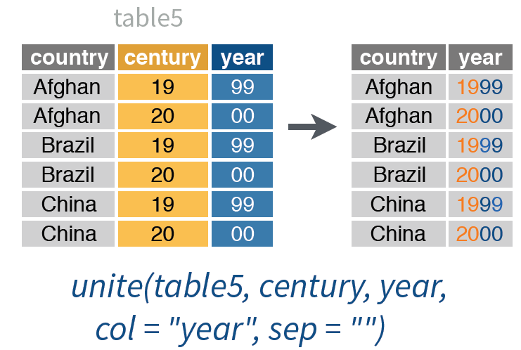
Use unite to collapse cells across several columns
to make a single column
rstudio cheatsheets

Slide 34

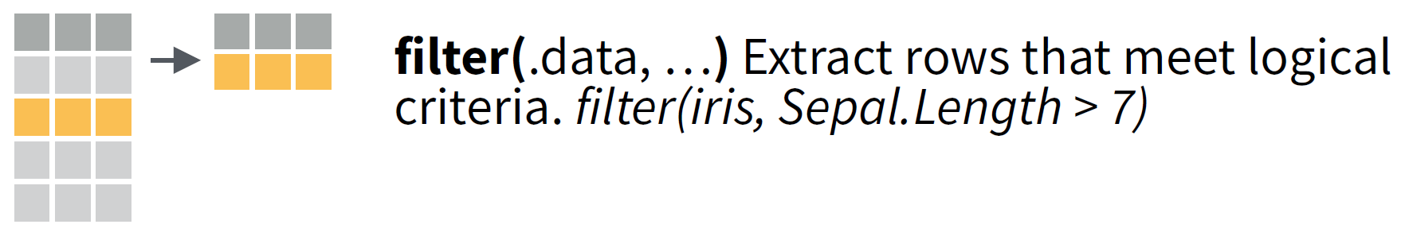
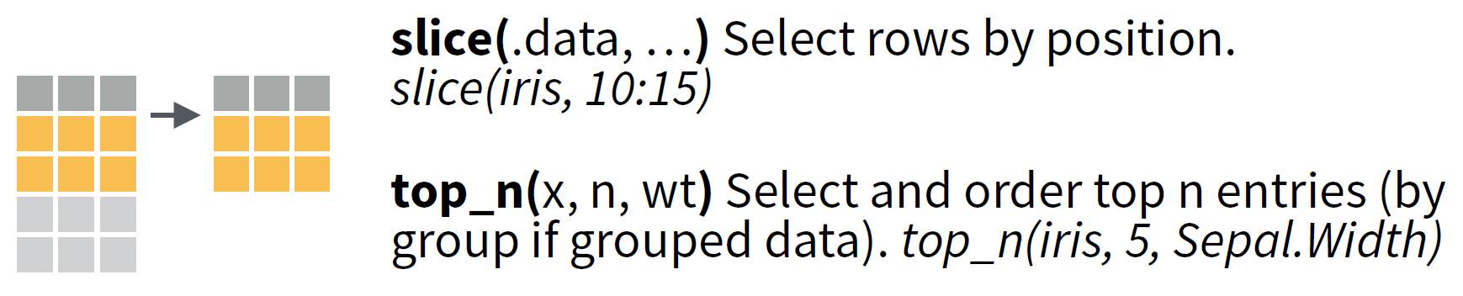
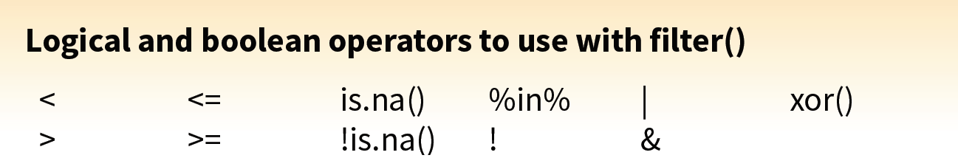
Use filter to filter rows with a logical statement, slice
to select specific rows, and top_n to keep top n rows
rstudio cheatsheets

Slide 35
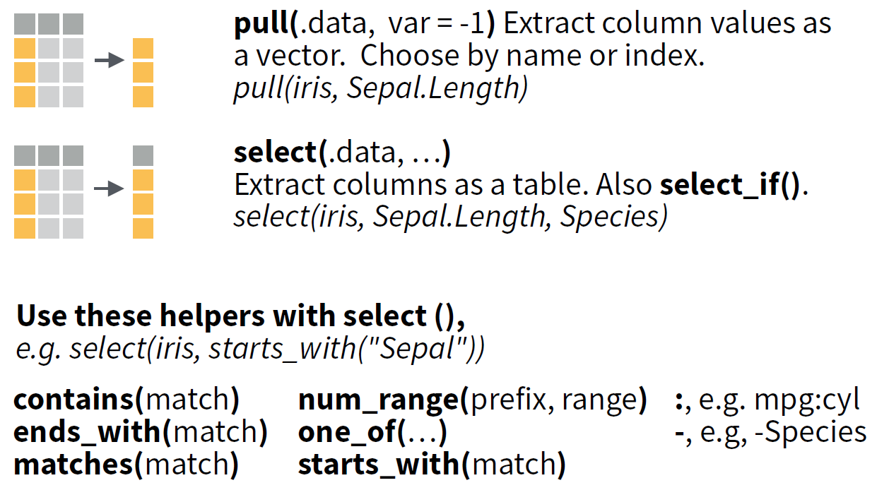
Use select to select variables as a table,
and pull to extract variable as a vector
rstudio cheatsheets

Slide 36
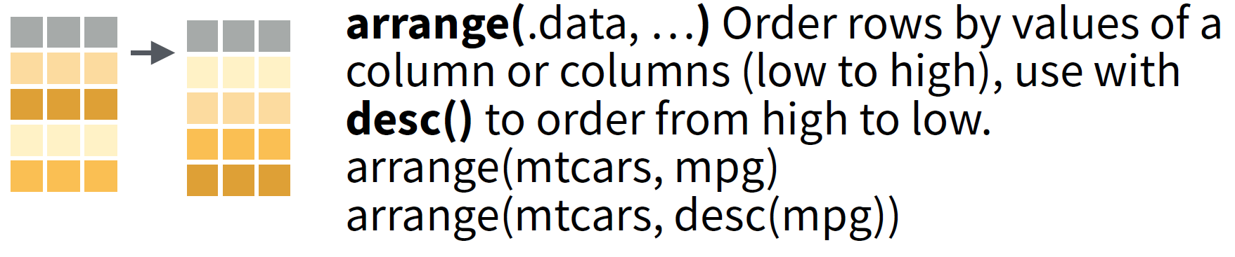
Use arrange to order rows in data frames
rstudio cheatsheets

Slide 37
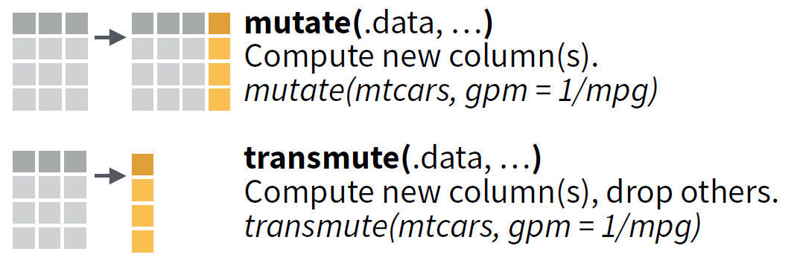

Use the vectorized functions mutate and transmute
to make new variables
rstudio cheatsheets

Slide 38
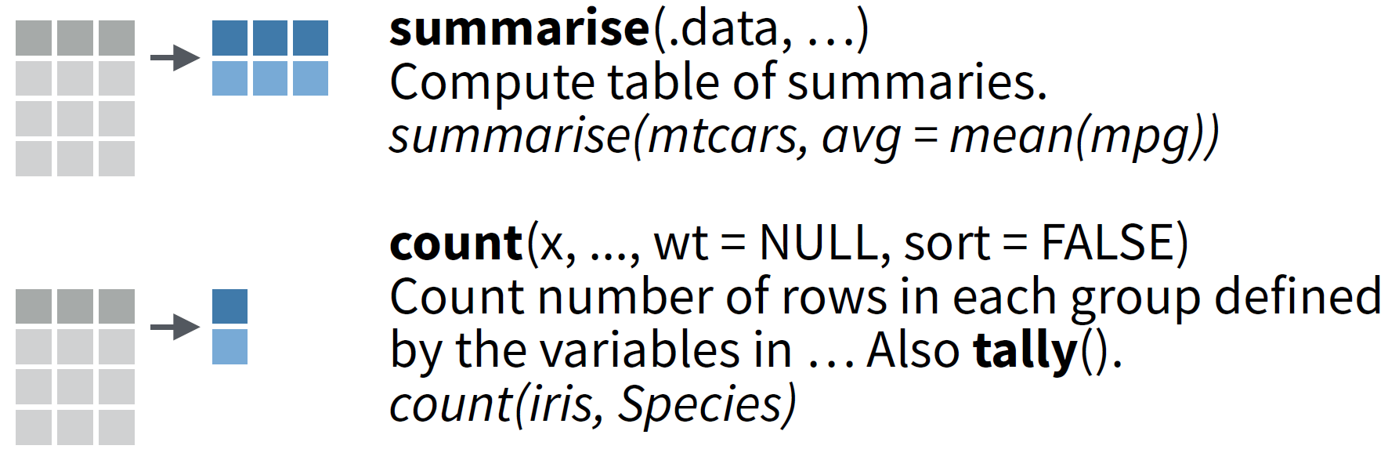

Use the summary functions summarise and count
to create a table of summary statistics
rstudio cheatsheets

Slide 39
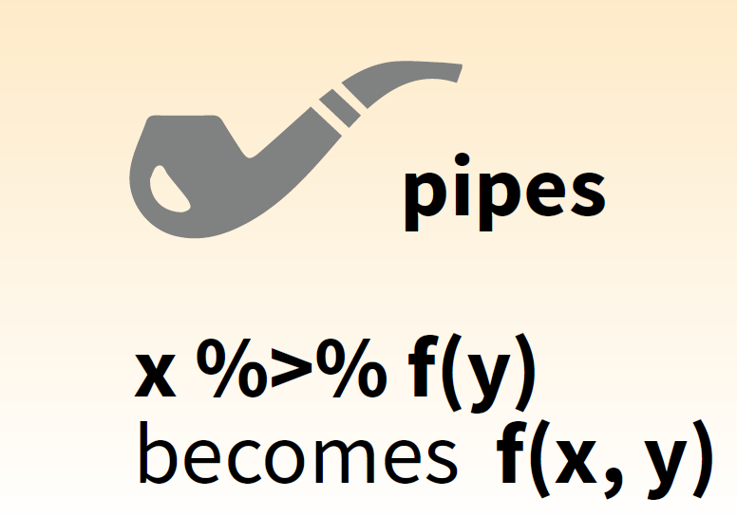
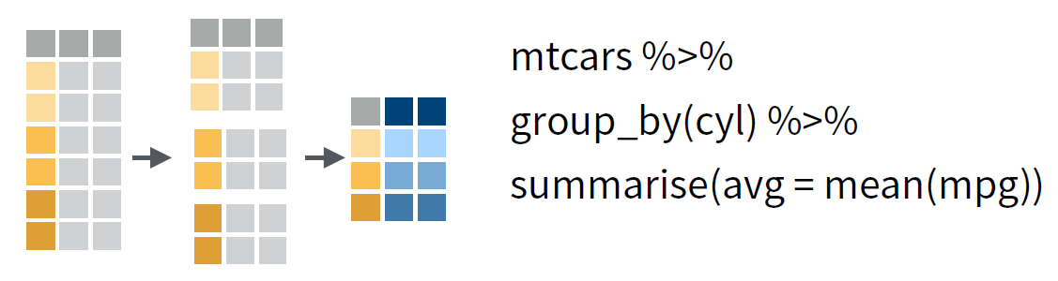
Use group_by to create a “grouped” copy of a table;
dplyr functions will manipulate each “group”
separately and then combine the results
rstudio cheatsheets

Slide 40
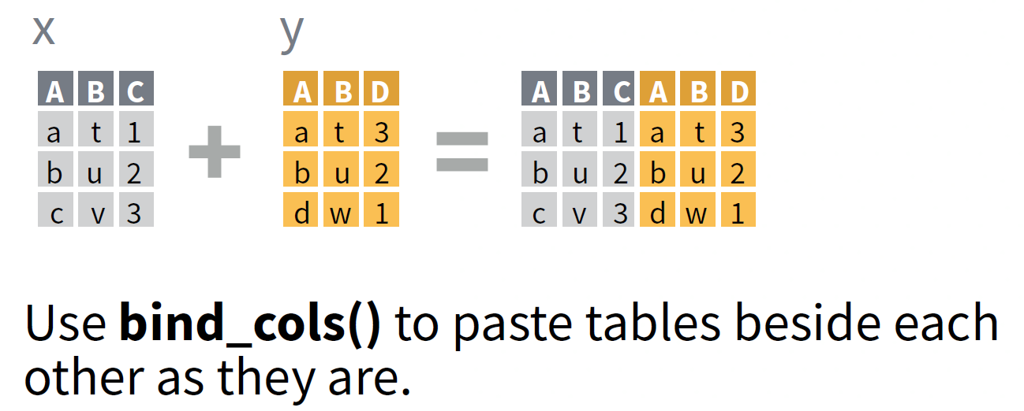
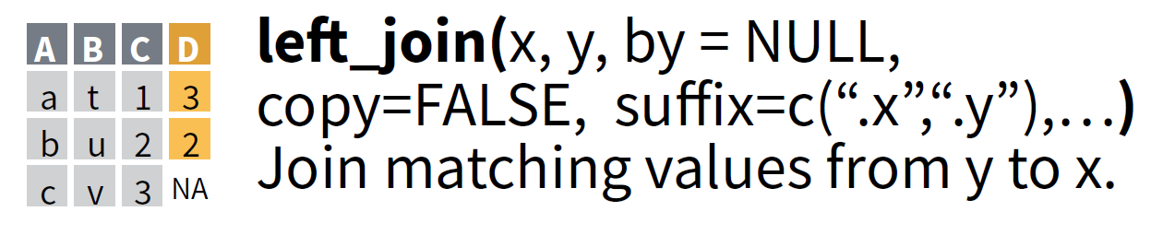
Use bind_cols or (preferably) left_join
to combine tables
rstudio cheatsheets

Slide 41
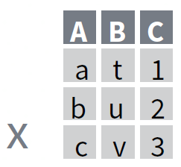
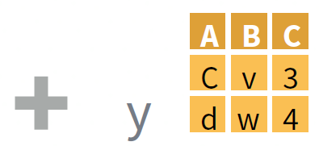
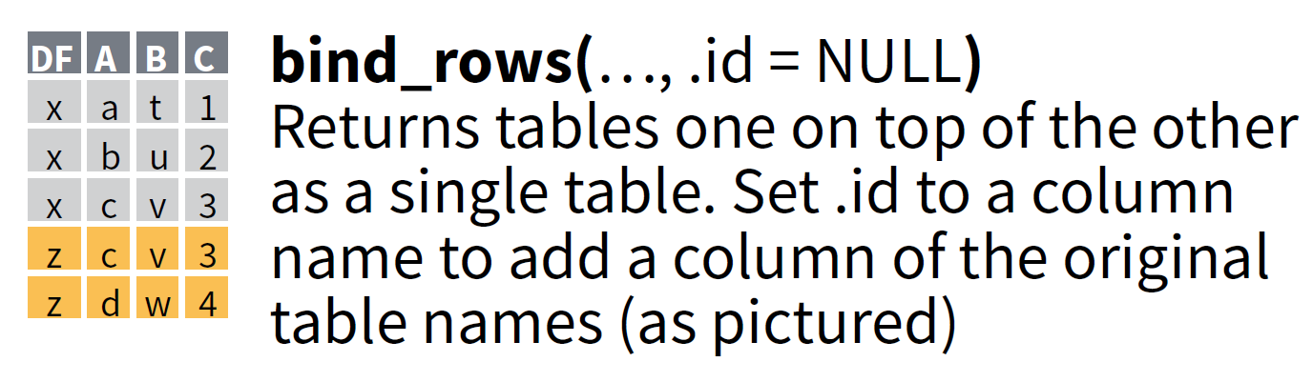
Use bind_rows to paste tables below each other
as they are
rstudio cheatsheets

Slide 42
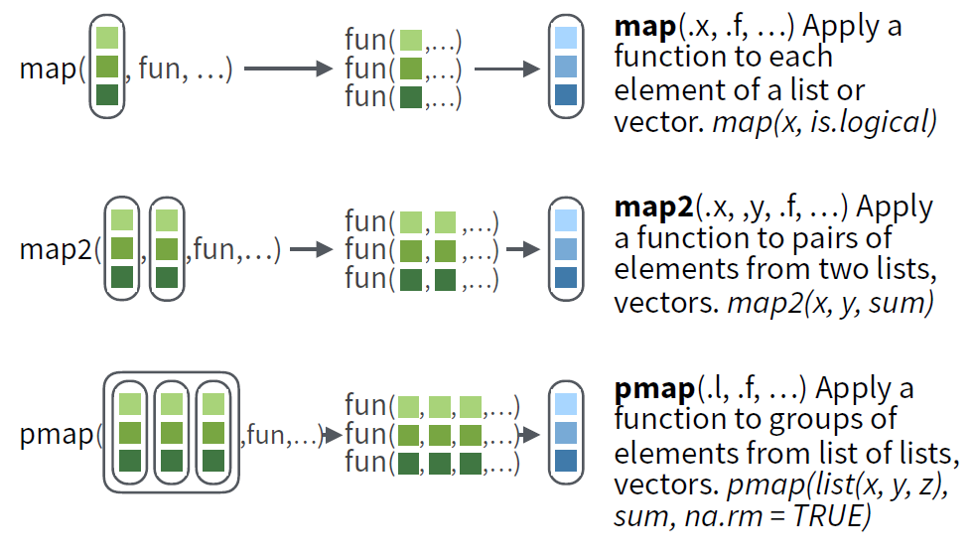
Use map, map2 or pmap to iterate
(i.e. to do a repetitive task over and over again)
rstudio cheatsheets

Slide 43
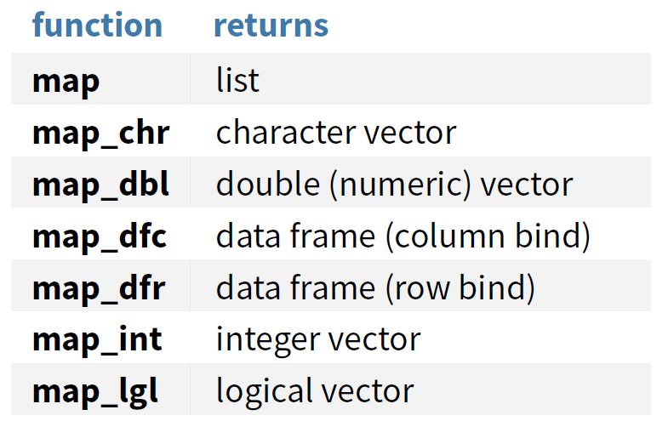
Use map_*, map2_* or pmap_*
to return output other than a list
rstudio cheatsheets

Slide 44

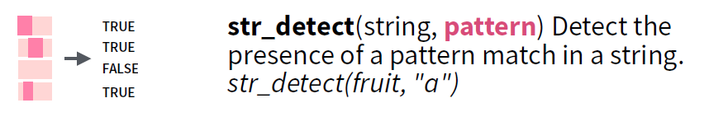
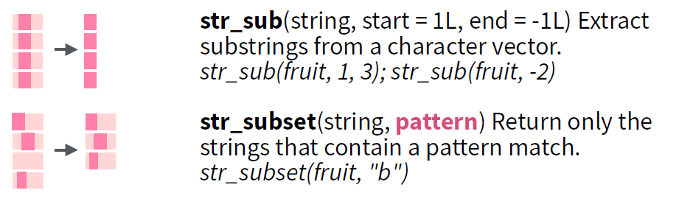
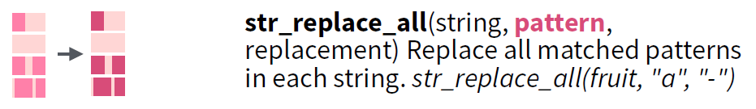
Use the str_* family of functions to detect, subset
or mutate strings (i.e. text or character vectors)
rstudio cheatsheets

Slide 45




Use the fct_* family of functions to work with factors
(R’s data structure for categorical data)
rstudio cheatsheets

Slide 46

Use the ymdhms functions to convert
strings or numbers to date-times
rstudio cheatsheets

Slide 47
A directory of visualizations

Slide 48


How would you visualize …
amounts with one set of categories?
https://serialmentor.com/dataviz/
Notes:
The most common approach to visualizing amounts (i.e., numerical values shown for some set of categories) is using bars, either vertically or horizontally arranged. However, instead of using bars, we can also place dots at the location where the corresponding bar would end.

Slide 49



How would you visualize …
amounts with two or more set of categories?
https://serialmentor.com/dataviz/
Notes:
If there are two or more sets of categories for which we want to show amounts, we can group or stack the bars. We can also map the categories onto the x and y axis and show amounts by color, via a heatmap.

Slide 50


How would you visualize …
a single distribution?
https://serialmentor.com/dataviz/
Notes:
Histograms and density plots provide the most intuitive visualizations of a distribution, but both require arbitrary parameter choices and can be misleading. Cumulative densities and quantile-quantile (q-q) plots always represent the data faithfully but can be more difficult to interpret.

Slide 51

How would you visualize …
many distributions?
https://serialmentor.com/dataviz/
Notes:
Boxplots, violins, strip charts, and sina plots are useful when we want to visualize many distributions at once and/or if we are primarily interested in overall shifts among the distributions. Stacked histograms and overlapping densities allow a more in-depth comparison of a smaller number of distributions, though stacked histograms can be difficult to interpret and are best avoided. Ridgeline plots can be a useful alternative to violin plots and are often useful when visualizing very large numbers of distributions or changes in distributions over time.

Slide 52


How would you visualize …
a single proportion?
https://serialmentor.com/dataviz/
Notes:
Proportions can be visualized as pie charts, side-by-side bars, or stacked bars, and as in the case for amounts, bars can be arranged either vertically or horizontally. Pie charts emphasize that the individual parts add up to a whole and highlight simple fractions. However, the individual pieces are more easily compared in side-by-side bars. Stacked bars look awkward for a single set of proportions, but can be useful when comparing multiple sets of proportions (see below).

Slide 53


How would you visualize …
many proportions?
https://serialmentor.com/dataviz/
Notes:
When visualizing multiple sets of proportions or changes in proportions across conditions, pie charts tend to be space-inefficient and often obscure relationships. Grouped bars work well as long as the number of conditions compared is moderate, and stacked bars can work for large numbers of conditions. Stacked densities are appropriate when the proportions change along a continuous variable.

Slide 54

How would you visualize …
nested proportions?
https://serialmentor.com/dataviz/
Notes:
When proportions are specified according to multiple grouping variables, then mosaic plots, treemaps, or parallel sets are useful visualization approaches. Mosaic plots assume that every level of one grouping variable can be combined with every level of another grouping variable, whereas treemaps do not make such an assumption. Treemaps work well even if the subdivisions of one group are entirely distinct from the subdivisions of another. Parallel sets work better than either mosaic plots or treemaps when there are more than two grouping variables.

Slide 55


How would you visualize …
an x-y relationship?
https://serialmentor.com/dataviz/
Notes:
Scatterplots represent the archetypical visualization when we want to show one quantitative variable relative to another. If we have three quantitative variables, we can map one onto the dot size, creating a variant of the scatterplot called bubble chart. For paired data, where the variables along the x and the y axes are measured in the same units, it is generally helpful to add a line indicating x = y. Paired data can also be shown as a slope graph of paired points connected by straight lines.

Slide 56

How would you visualize …
an x-y relationship that suffers from overplotting?
https://serialmentor.com/dataviz/
Notes:
For large numbers of points, regular scatterplots can become uninformative due to overplotting. In this case, contour lines, 2D bins, or hex bins may provide an alternative.

Slide 57

How would you visualize …
a trend in a x-y relationship?
https://serialmentor.com/dataviz/
Notes:
We can use smooth lines to represent trends in a larger dataset.

Slide 58

How would you visualize …
many x-y relationships?
https://serialmentor.com/dataviz/
Notes:
When we want to visualize more than two quantities, on the other hand, we may choose to plot correlation coefficients in the form of a correlogram (or heatmap) instead of the underlying raw data.

Slide 59

How would you visualize …
temporal relationships (time-series)?
https://serialmentor.com/dataviz/
Notes:
When the x axis represents time or a strictly increasing quantity such as a treatment dose, we commonly draw line graphs. If we have a temporal sequence of two response variables, we can draw a connected scatterplot where we first plot the two response variables in a scatterplot and then connect dots corresponding to adjacent time points.

Slide 60


How would you visualize …
geospatial data?
https://serialmentor.com/dataviz/
Notes:
The primary mode of showing geospatial data is in the form of a map. A map takes coordinates on the globe and projects them onto a flat surface, such that shapes and distances on the globe are approximately represented by shapes and distances in the 2D representation. In addition, we can show data values in different regions by coloring those regions in the map according to the data. Such a map is called a choropleth. In some cases, it may be helpful to distort the different regions according to some other quantity (e.g., population number) or simplify each region into a square. Such visualizations are called cartograms.

Slide 61


How would you visualize …
uncertainty?
This is the one
we use to create
forestplots
https://serialmentor.com/dataviz/
Notes:
Error bars are meant to indicate the range of likely values for some estimate or measurement. They extend horizontally and/or vertically from some reference point representing the estimate or measurement. Reference points can be shown in various ways, such as by dots or by bars. Graded error bars show multiple ranges at the same time, where each range corresponds to a different degree of confidence. They are in effect multiple error bars with different line thicknesses plotted on top of each other.

Slide 62


How would you visualize …
uncertainty with more detail?
https://serialmentor.com/dataviz/
Notes:
To achieve a more detailed visualization than is possible with error bars or graded error bars, we can visualize the actual confidence or posterior distributions. Confidence strips provide a clear visual sense of uncertainty but are difficult to read accurately. Eyes and half-eyes combine error bars with approaches to visualize distributions (violins and ridgelines, respectively), and thus show both precise ranges for some confidence levels and the overall uncertainty distribution. A quantile dot plot can serve as an alternative visualization of an uncertainty distribution. By showing the distribution in discrete units, the quantile dot plot is not as precise but can be easier to read than the continuous distribution shown by a violin or ridgeline plot.

Slide 63


How would you visualize …
uncertainty of smooth line graphs?
https://serialmentor.com/dataviz/
Notes:
For smooth line graphs, the equivalent of an error bar is a confidence band. It shows a range of values the line might pass through at a given confidence level. As in the case of error bars, we can draw graded confidence bands that show multiple confidence levels at once. We can also show individual fitted draws in lieu of or in addition to the confidence bands.

Slide 64
The grammar of graphics

Slide 65


Grammar is the way we arrange words
to make proper sentences

Slide 66

The grammar of graphics is the way we arrange
variables to make graphs; it’s a plotting framework
Variables of interest
The dataset being plotted
The scales onto which we map our data
The visual elements used for our data
Plotting small multiples
Representations of our data to aid understanding
The space on which the data will be plotted
All non-data ink

Slide 67

We build plots by adding layers of grammatical
elements on top of each other

Slide 68



We build plots using layers
rstudio cheatsheets

Slide 69
Check out
the 03-eda script

Slide 70
Check out
the 04-model script

Slide 71
Check out
the 02-input script

Slide 72
Overview

Slide 73


Slide 74


Slide 75

R is a computer language for scientists

Slide 76





We download R from one of two sources
(depending on your user rights)
r-project.org
Software Center

Slide 77



Base R comes with a number of useful functions; you can also install new packages and thereby add functionality

Slide 78



We download most packages from CRAN, but we can also download packages from e.g. Bioconductor and GitHub
BiocManager::install("limma")
install.packages("dplyr")
Downloads files to computer
Do this once per computer
devtools::install_github("tidyverse/dplyr")
Loads package
Do this once every session
library(dplyr)

Slide 79

The tidyverse is a collection of R packages
that unify some common data science tasks

Slide 80

The tidyverse itself is a package; use it to install and load a whole bunch of useful packages and functions

Slide 81

Use the tidyverse website as a reference guide
Take a look!
https://www.tidyverse.org/
Notes:
Follow the link and look around at the tidyverse website

Slide 82




R is an engine, and RStudio puts you in the driver’s seat

Slide 83



We use the RStudio IDE, and write code in RMarkdown
Literate programming
rmarkdown
Effective work
RStudio IDE
Take a look!
https://rstudio.com/products/rstudio/

Slide 84





We download RStudio from one of two sources
(depending on your user rights)
rstudio.com
Software Center

Slide 85
Resources

Slide 86






Books on data science and statistics in R
https://r4ds.had.co.nz/
http://www.cookbook-r.com/
https://rstudio-education.github.io/hopr/
https://moderndive.com/
https://rafalab.github.io/dsbook/

Slide 87








Books on data visualization in R
https://ggplot2-book.org/
https://r-graphics.org/
https://www.edwardtufte.com/tufte/
https://socviz.co/
https://serialmentor.com/dataviz/

Slide 88








Books on advanced topics in R #1
http://compgenomr.github.io/book/
http://appliedpredictivemodeling.com/
http://www.feat.engineering/index.html
https://adv-r.hadley.nz/
https://web.stanford.edu/~hastie/ElemStatLearn/
https://advanced-r-solutions.rbind.io/
http://faculty.marshall.usc.edu/gareth-james/ISL/

Slide 89







Books on advanced topics in R #2
https://bookdown.org/yihui/bookdown/
https://bookdown.org/yihui/rmarkdown/
https://bookdown.org/yihui/blogdown/
http://r-pkgs.had.co.nz/
https://csgillespie.github.io/efficientR/
https://www.tidytextmining.com/
https://www.datascienceatthecommandline.com/

Slide 90

rstudio::conf 2019 courses are freely available
Take a look!
https://github.com/AmeliaMN/data-science-in-tidyverse
Notes:
Follow the link and look around at the github repo
Show how to download a repo to use locally

Slide 91







Keep the R4DS book close, but keep the cheatsheets closer
https://rstudio.com/resources/cheatsheets/
Data import:
tidyr
haven
Data visualization:
ggplot2
RColorBrewer
Take a look!
Data transformations:
dplyr
Strings/text:
stringr
Dates and times:
lubridate
Iteration:
purrr
Categorical data:
forcats

